Slide 1



Project report for Olympic data analysis
Prepared by amar

Slide 2
Content
Review of Questions to Answer/ Hypothesis/Approach
Detail: Entity relationship diagram
Initial Findings
Deeper analysis
Hypothesis results.

Slide 3
Section 1 answers to the questions
Questions we are going to answer.
● Which country has achieved the highest number of medals?
● Which country has achieved the highest number of gold medals?.
● The top ten athletes who have earned gold, silver, and bronze medals.

Slide 4
Section 2 Hypothesis
1. In the realm of Olympic judo sports, Japan stands as the country with the most
gold medals won.
2. In the Olympic Games' ice hockey sports, Britain stands as the top gold
medal-winning country.

Slide 5
Section 3 approach
1. Initial feature explorations
To understand the distribution of age and proportions like sex ratio etc.
2. Handling missing values and outliers
Handling missing values and outlier's for higher accuracy analysis.
3. Plotting visualizations
Turning data into graphs and charts to understand the data for better decision making.

Slide 6
Entity relationship diagram

Slide 7
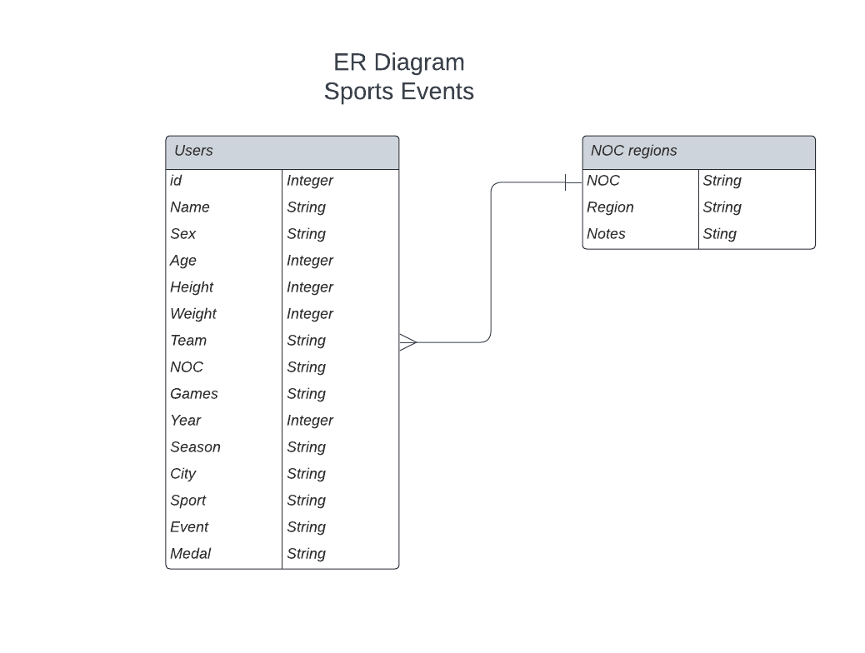

Slide 8
Initial feature exploration
It was observed that the proportion of male athletes participating is greater than that of female athletes.

Slide 9
There is compelling evidence suggesting that participants aged between 20 and 30 dominate the events.

Slide 10
Based on the observations, it is evident that the number of participations has consistently increased over successive years.
In the summer season, there is a greater number of participants compared to the winter season.

Slide 11
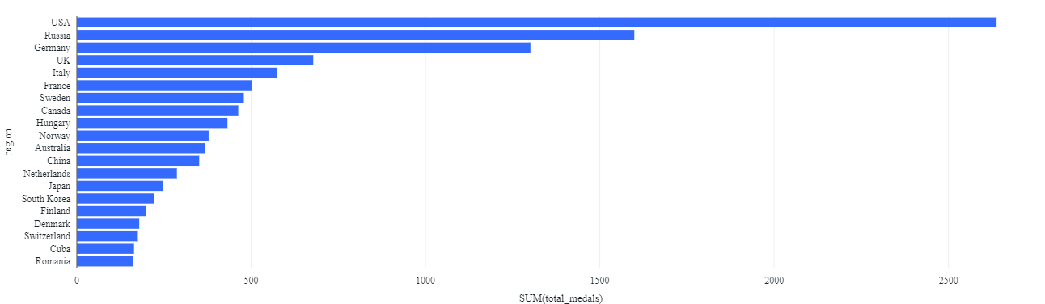
Deep analysis
Which country has achieved the highest number of gold medals?

Slide 12
US has achieved the highest number of gold medals

Slide 13
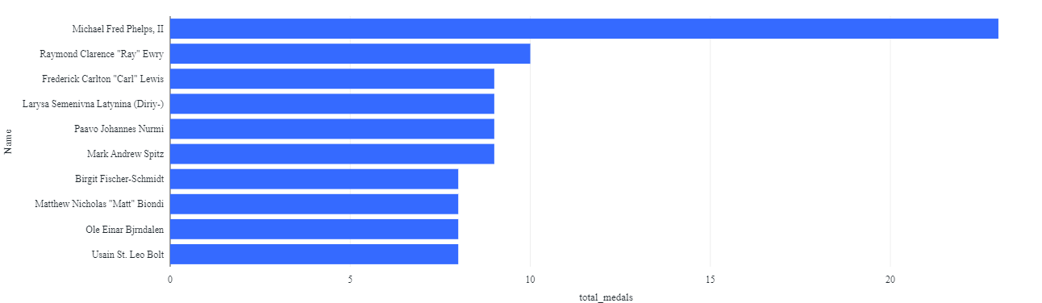
Top10 gold medal athletes
Michael Fred Phelps, II holds the record for the most gold medals won in history.

Slide 14
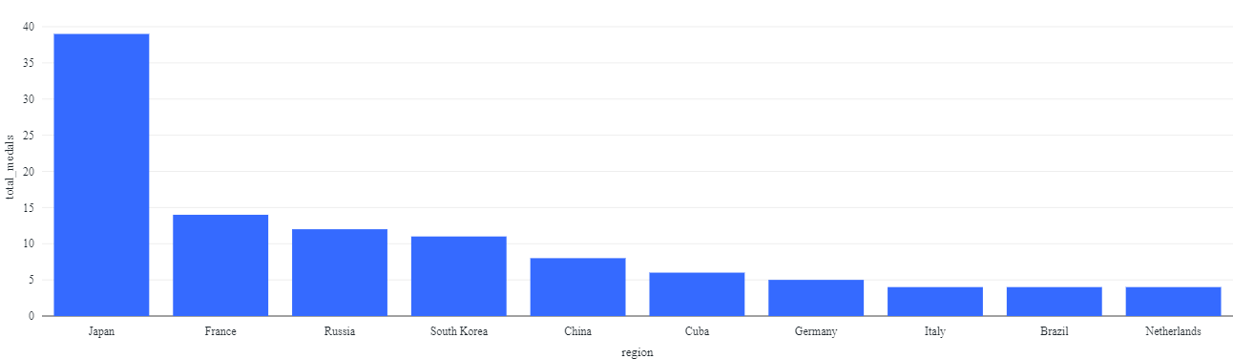
Hypothesis results
In the realm of Olympic judo sports, Japan stands as the country with the most
gold medals won.

Slide 15
Based on the observation, Japan holds the top position as the country with the highest number of gold medals won.
The observation indicates that there is statistically significant evidence supporting Japan as the country with the highest number of gold medals won.

Slide 16
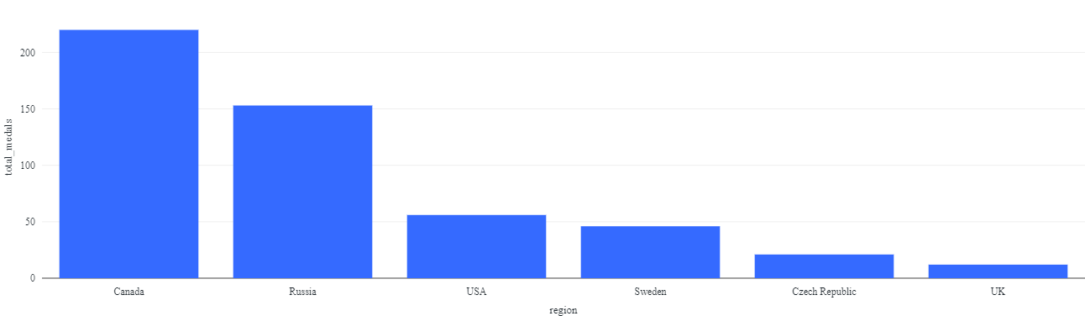
Hypothesis 2.
In the Olympic Games ice hockey sports, Britain stands as the top gold medal-winning country.

Slide 17
Based on the observation, Canada holds the top position as the country with the highest number of gold medals won.
The observation indicates that there is no statistically significant evidence supporting Britain(UK) as the country with the highest number of gold medals won as it satnds at 6th position.

